Slide 1
PHP OOP
Object Oriented Programming

Slide 2
Object Oriented Concept
Classes
Objects
Encapsulation
Inheritance

Slide 3
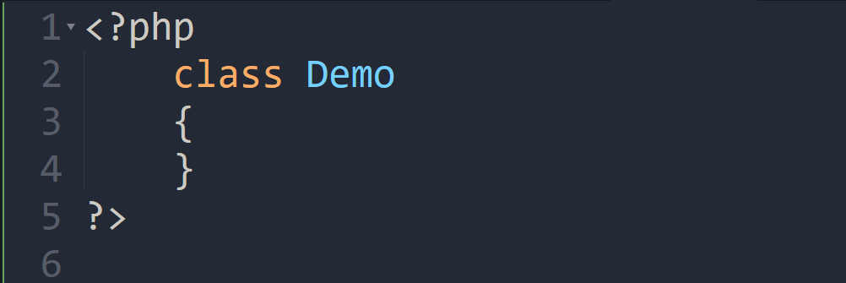
Creating Class

Slide 4
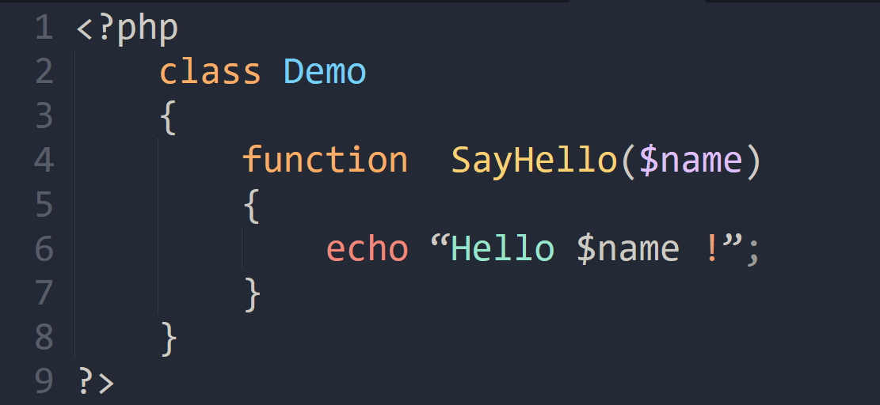
Adding Method

Slide 5
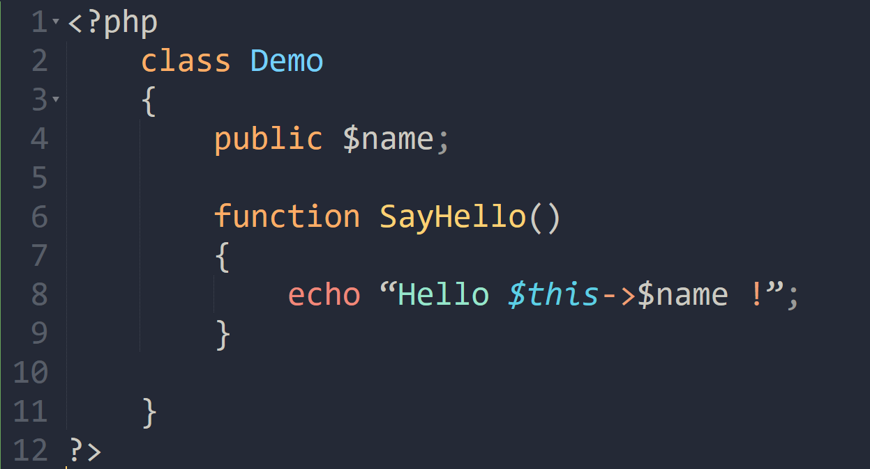
Adding Properties
Adding a property to your class is as easy as adding a method.

Slide 6
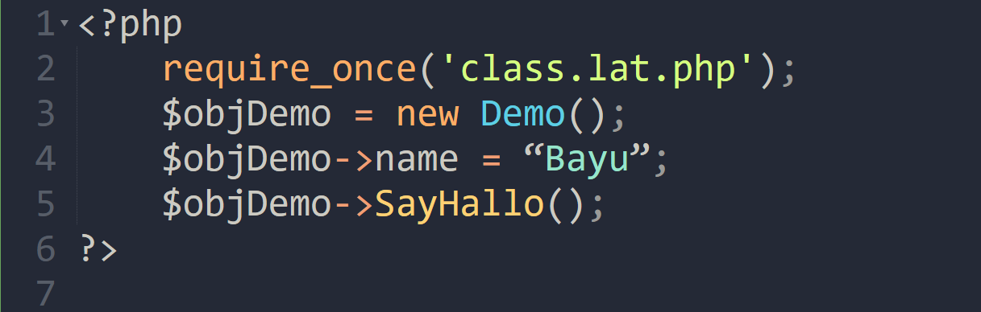
Object Instantiation
You can instantiate an object of type Demo like this:

Slide 7
Protecting Access to Member Variables (1)
There are three different levels of visibility that a member variable or method can have :
Public
members are accessible to any and all code
Private
members are only accessible to the class itself
Protected
members are available to the class itself, and to classes that inherit from it
Public is the default visibility level for any member variables or functions that do not explicitly set one, but it is good practice to always explicitly state the visibility of all the members of the class.

Slide 8
Protecting Access to Member Variables (2)
Try to change access level of property named “name” to private of previous code.
What the possible solution of this problem?
Make the getter and setter function...
Always use get and set functions for your properties. Changes to business logic and data validation requirements in the future will be much easier to implement.

Slide 9
Class Constants
It is possible to define constant values on a per-class basis remaining the same and unchangeable.
Constants differ from normal variables in that you don't use the $ symbol to declare or use them
The value must be a constant expression, not (for example) a variable, a property, a result of a mathematical operation, or a function call

Slide 10
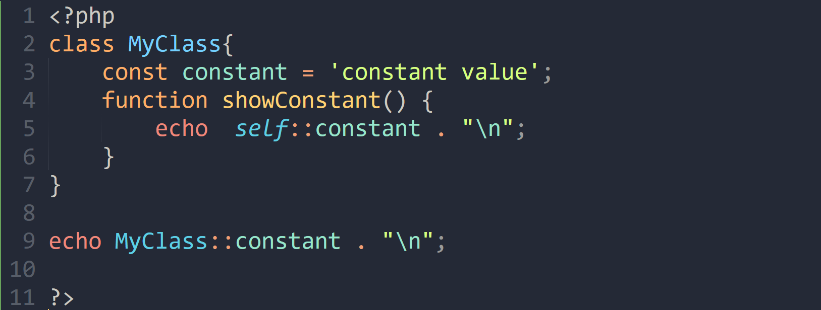
Class Constants (cont.)

Slide 11
Static Keyword
Declaring class properties or methods as static makes them accessible without needing an instantiation of the class.
A property declared as static can not be accessed with an instantiated class object

Slide 12
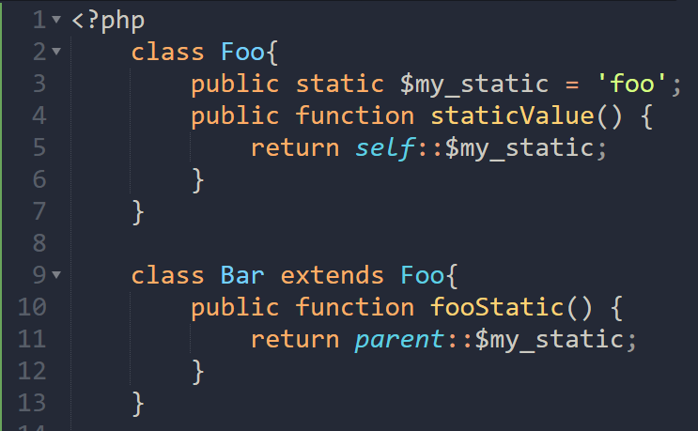
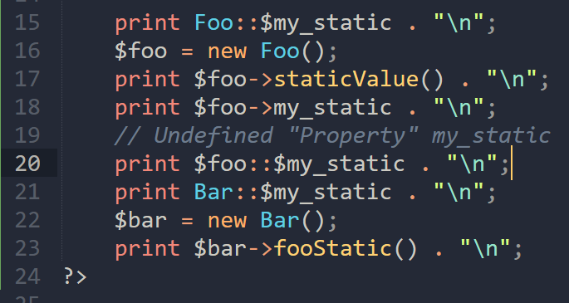

Slide 13
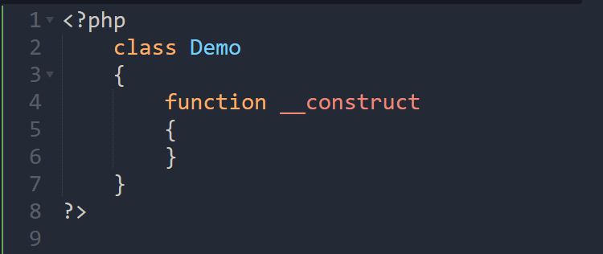
Constructor
Constructor is the method that will be implemented when object has been initiated
Commonly, constructor is used to initialize the object
Use function __construct to create constructor in PHP

Slide 14
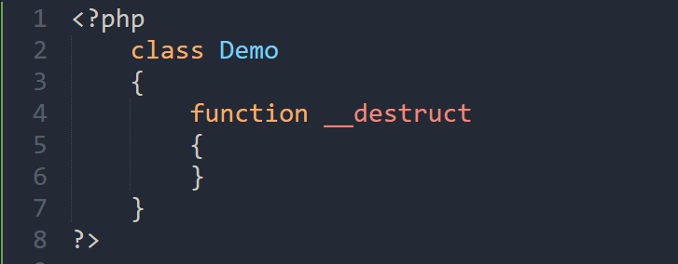
Destructor
Destructor, is method that will be run when object is ended

Slide 15
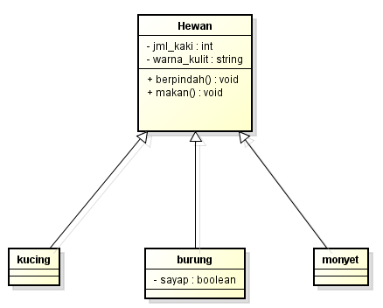
Inheritance
There are many benefits of inheritance with PHP, the most common is simplifying and reducing instances of redundant code.

Slide 16
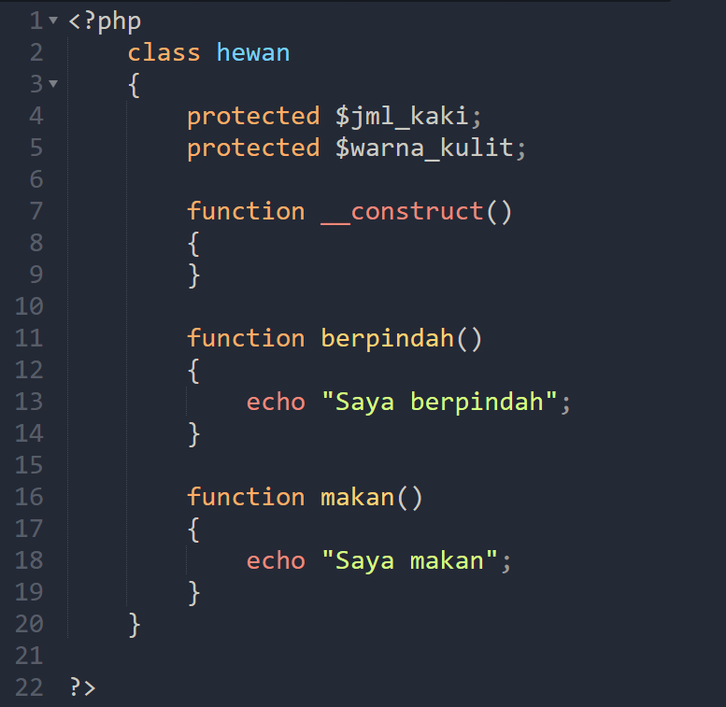
Inheritance (2)

Slide 17
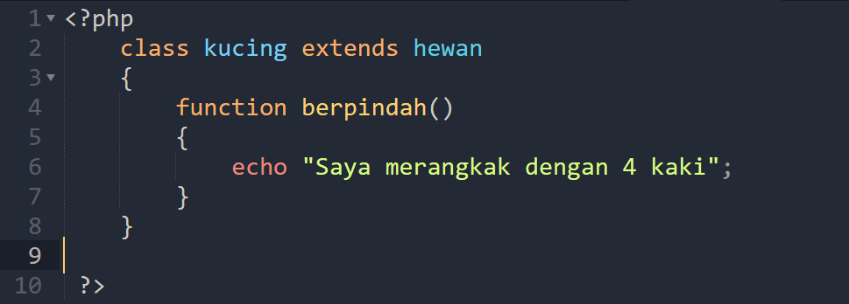
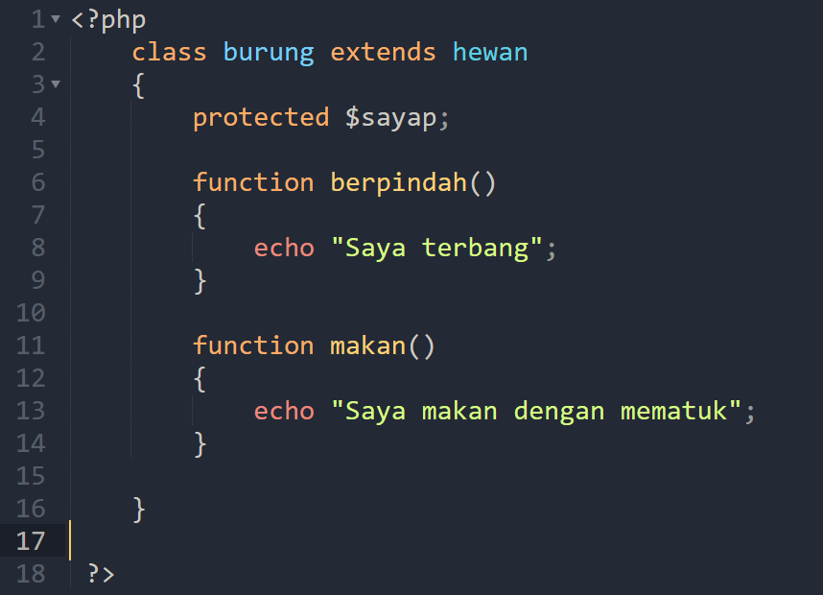
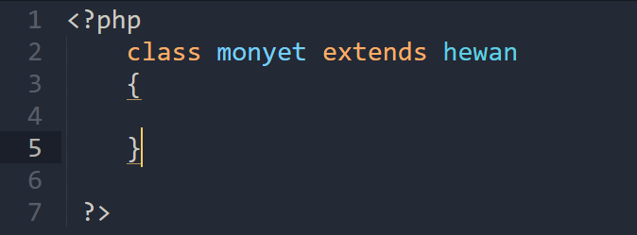
Inherintace (3)

Slide 18
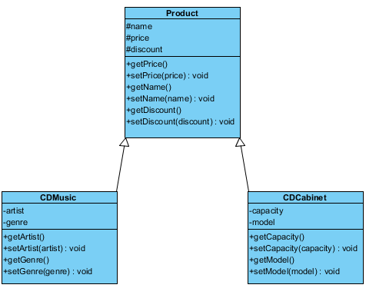
Tugas

Slide 19
Tugas (cont.)
Class product :
name
price
discount
Class CDMusic :
artist
Genre
Class CDRack
capacity
model

Slide 20
Tugas (cont.)
CDMusic
Menuruni name, price dan discount dari Product
Price = price + 10%
Ada penambahan 5% pada discount
CDRack
Menuruni name, price dan discount dari Product
Price = price + 15%
Tidak ada penambahan discount
Buatlah code dalam PHP, serta simulasi untuk kasus tersebut!

Slide 21
Thank You

